Slide 2
Metods for evaluating the algorithm

Slide 3
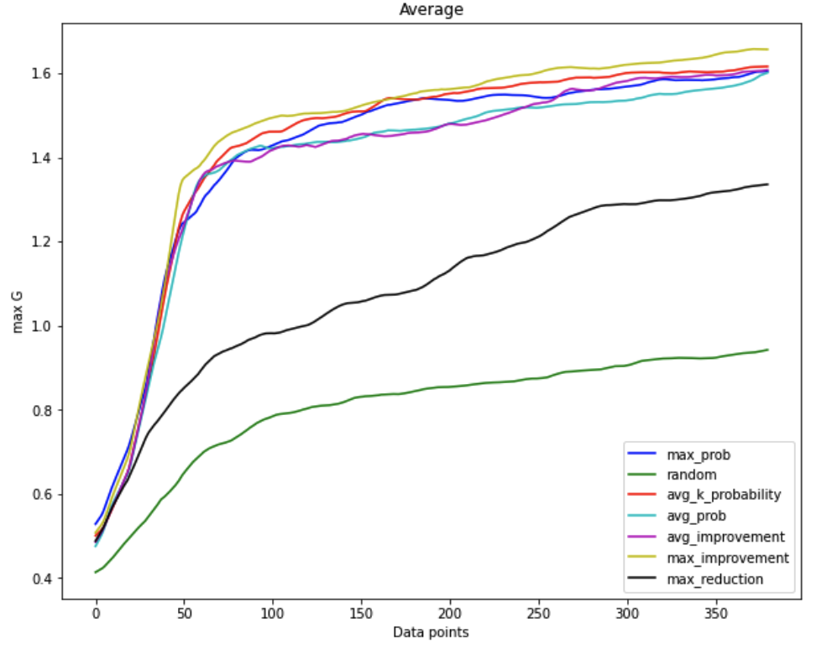
Maximum gradient observed

Slide 4
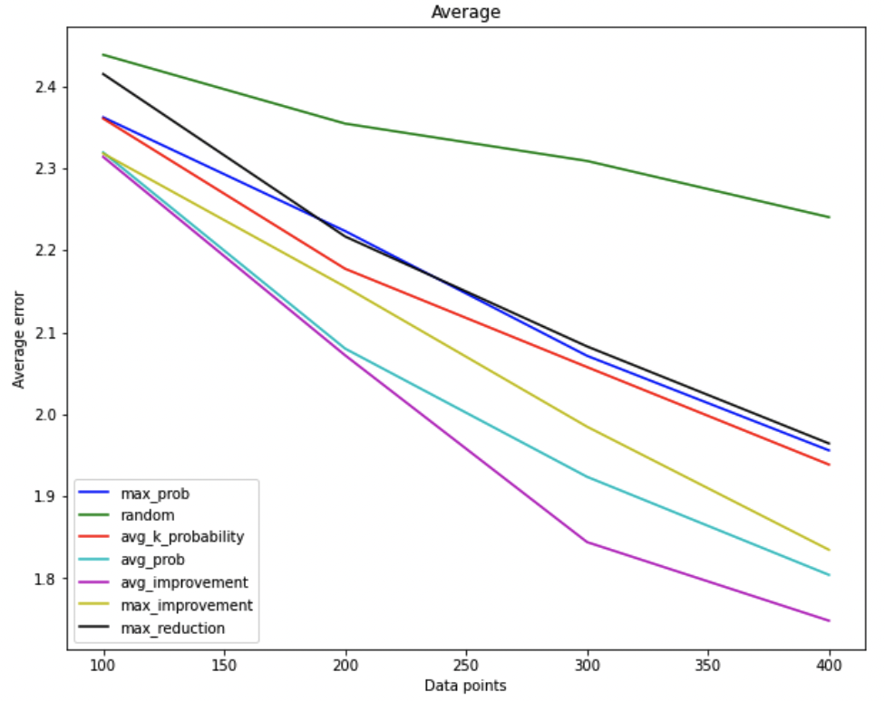
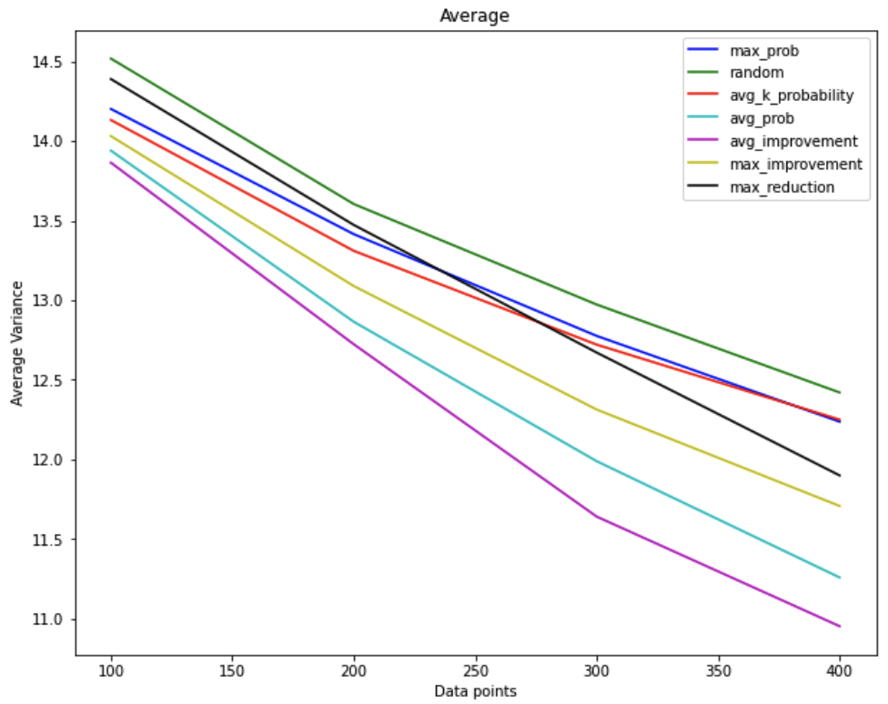
Mean error and variance reduction This is done by krieging after the experiment

Slide 5
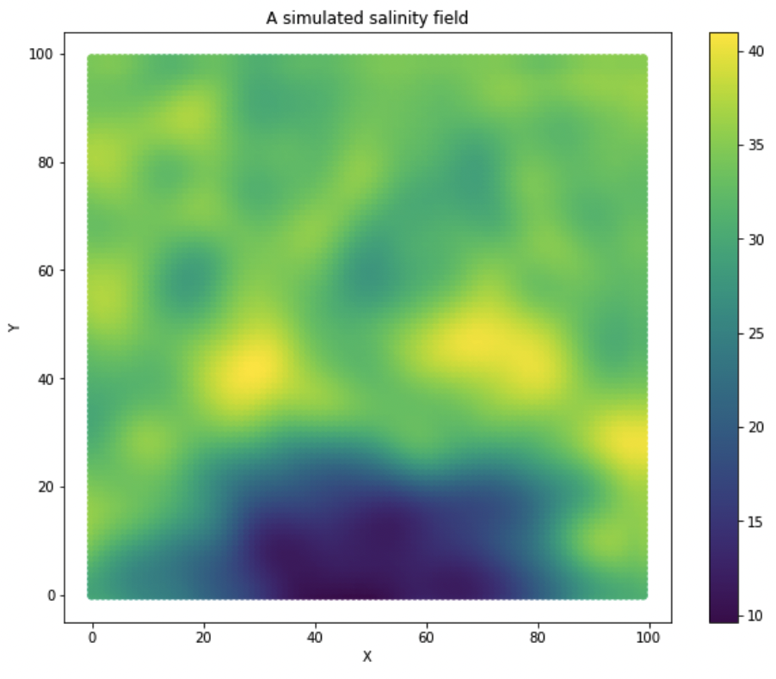
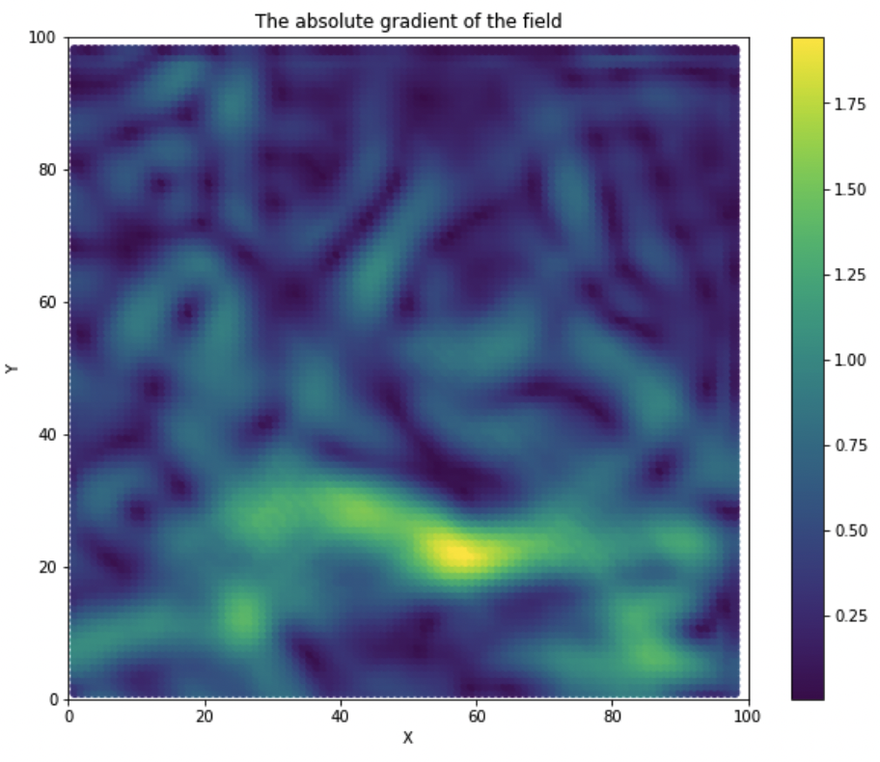
Salinity and gradient field

Slide 6
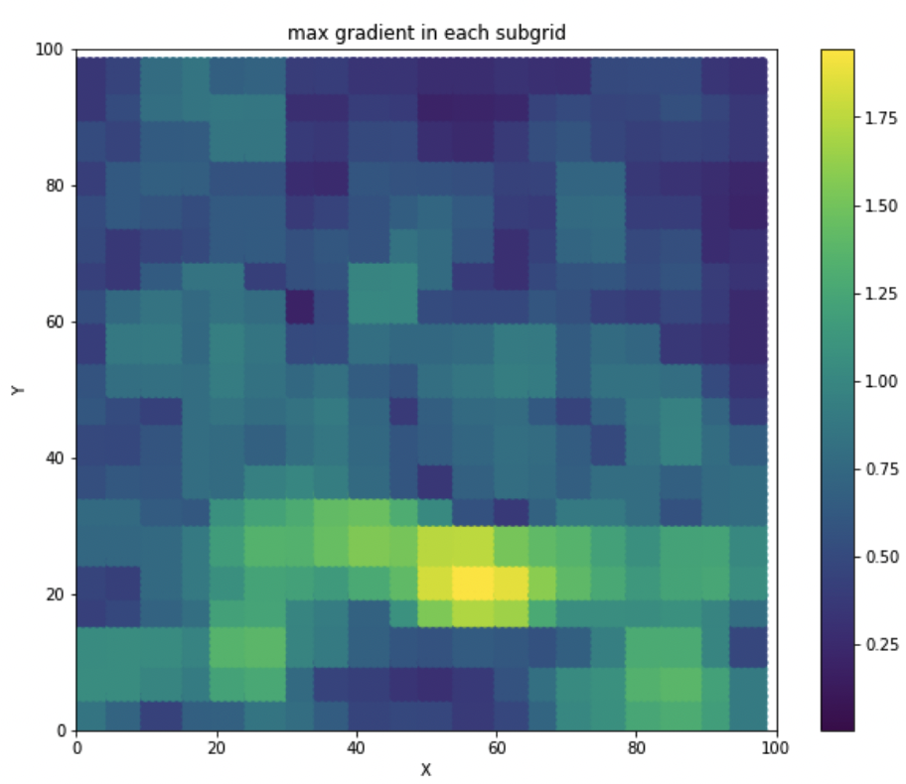
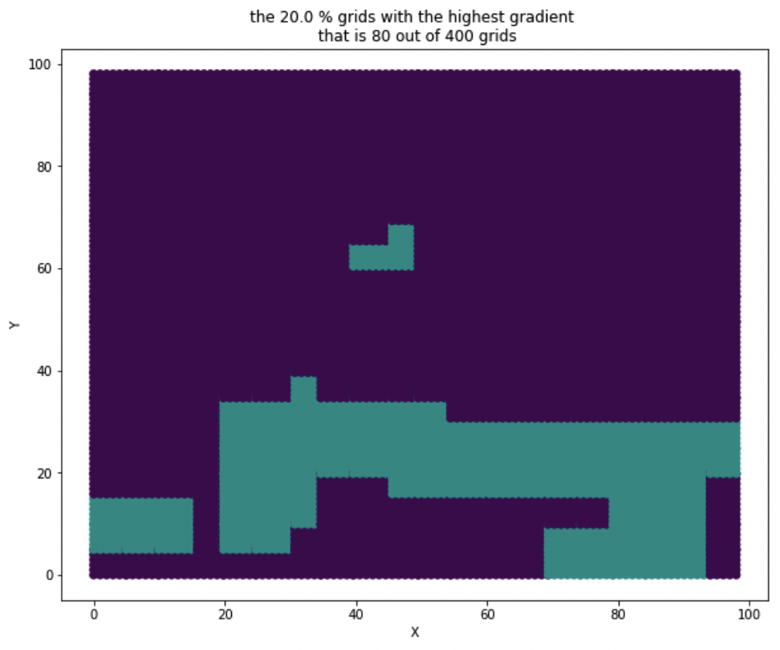
Splitting the grid into sub grids

Slide 7
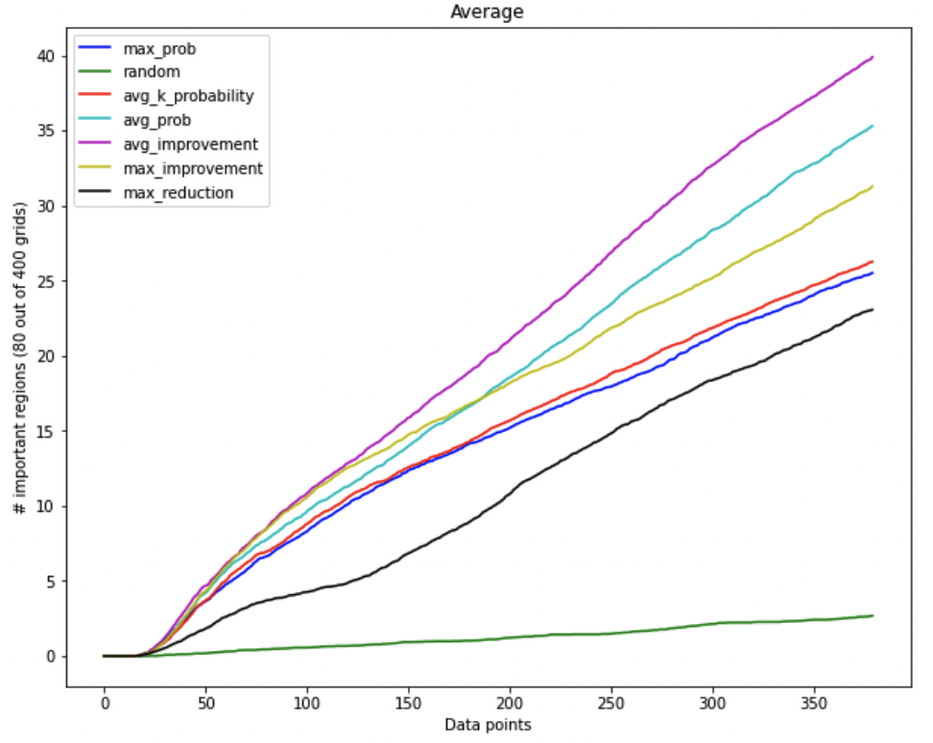
Which algorithm vistis most important regions

Slide 8
We can also add RMSE and mean variance inside these important regions
These regions can also be based on a percentage of the max gradient.

Slide 9
Future plans
Yaolin will deliver his paper soon (hopefully Tuesday)
Field experiment
Possible dates
22. - 26. May ← Plan A
After 20. June (We do not know when Karoline will be back)
Will also run Martins experiment

